Slide 1
Data Lake Storage Integration
Integrate Azure Data Factory
with Azure Data Lake Storage
Tharankhini K G
Job Aoushadan N
Nevetha S K
Theophila Murphy S

Slide 2
Table of Contents
Project Statement
Project Overview
Prerequisites
Project Requirements
Azure Resources
Project Objectives
Execution Overview
Implementation
Steps on practical implementation on Azure portal
Successful output generated
Conclusion

Slide 3
Project Statement
Data Lake Storage Integration. Integrate Azure Data Factory with Azure Data Lake Storage. Develop a pipeline that moves data between different folders in the Data Lake, with version control managed through Azure DevOps.

Slide 4
Project Overview
The integration of Azure Data Factory with Azure Data Lake Storage to enable efficient and automated data movement across folders within the Data Lake.
By leveraging ADF pipelines, we orchestrate the transfer, transformation, and organization of data while ensuring scalability and reliability.
To maintain transparency and collaboration, Azure DevOps is used for version control and CI/CD enabling teams to track changes and manage pipeline configurations.

Slide 5
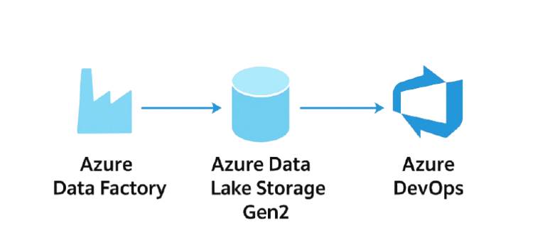
Prerequisites
Azure Subscription
Azure Data Factory
Azure Data Lake Storage (ADLS Gen2)
Containers
Source folder
Destination folder
Azure Storage Account
Azure Repos Git Repository

Slide 6
Project Requirements
Technical Infrastructure:
Azure Data Factory : Pipeline orchestration
Azure Data Lake Storage Gen2
Storage Accounts: Data Lake Gen2 enabled
ADF Git Configuration enabled in Azure Data Factory Studio
Data Sources and Destinations:
Source Data Specifications: Identification of data sources
Destination Specifications: Determination of target storage solutions

Slide 7
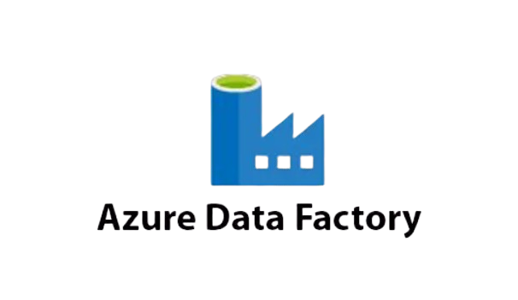
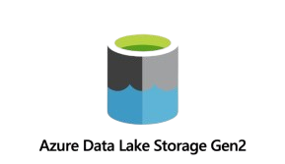
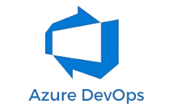
Azure Resources
Azure Data Factory
Pipeline orchestration and automation
Data Lake Storage
Gen2
Centralized data repository
Azure DevOps
Version control & CI/CD

Slide 8
Project Objectives
Automate Data Transfer Streamline folder-to-folder movement in Azure Data Lake Storage
Version Control Maintain pipeline definitions with Azure DevOps Git Integration for collaboration and rollback.
Scheduling & Monitoring Enable scheduled executions and real-time monitoring dashboards in Azure Data Factory.

Slide 9
Execution Overview
Create resources in Azure (ADF instance, ADLS Gen2 account, source & sink folders)
Configure Git integration with Azure DevOps for version control.
Set up Linked Services to connect ADF with ADLS, and create Source & Sink Datasets pointing to the respective folders.
Build a pipeline with a copy data activity linking source and sink datasets. Verify, debug and publish

Slide 10
Execution Overview
Objective: Architect and build all pipeline components.
Key Principle: Construction and configuration before any data movement.
Analogy: Drawing the architectural plans for a building.
Azure Storage and Data Factory
Before you begin with the data transfer pipeline, you need to set up the necessary components like Azure Storage account, Data Factory.

Slide 11
Implementation
Resource Preparation
Git Integration
Linked Services
ADF to ADLS Gen 2
Dataset Creation
(Source & Sink)
Pipeline Creation
Copy Activity
Publishing
Monitoring & Automate

Slide 12
Azure Data Factory Data Pipeline Process
Prepare Resources
Create Azure Data Factory (ADF) instance
Create Azure Data Lake Storage (ADLS) Gen2 account
Set up source and sink folders/containers
Configure Git Integration
Connect ADF to a Git repository
Enables version control, collaboration, and change history tracking

Slide 13
Create Linked Services
Link ADF to ADLS Gen2 using connection strings
Acts as the bridge between ADF and storage
Define Datasets
Source Dataset → input file path
Sink Dataset → output folder in ADLS
Provides ADF with exact data references
Build Pipeline
Use Copy Activity to move data from source → sink
Managed by the Integration Runtime

Slide 14
Debug & Publish
Debug → test pipeline execution for errors
Publish → deploy to live ADF and sync with Git
Verify & Monitor
Verify and Monitor
After publishing, go to the Monitor tab to see your pipeline runs.
You can Trigger Now to manually run the pipeline or set up a trigger for automation.
Finally, check your Azure Data Lake Storage to confirm the file has been moved to the destination folder.

Slide 15
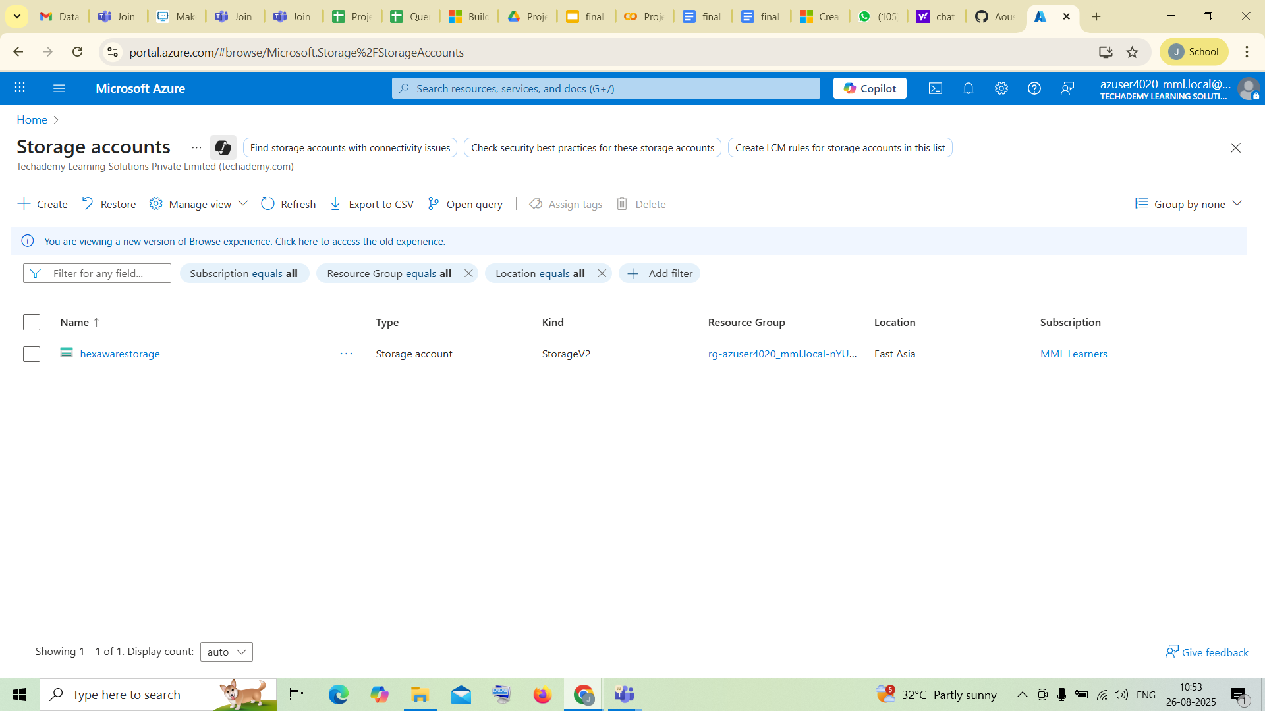
Steps on practical implementation on Azure portal
Create a Storage Account
The first step is to create an Azure Storage Account.
This is where your data will reside.
Navigate to the Azure portal and create a new Storage Account.

Slide 16
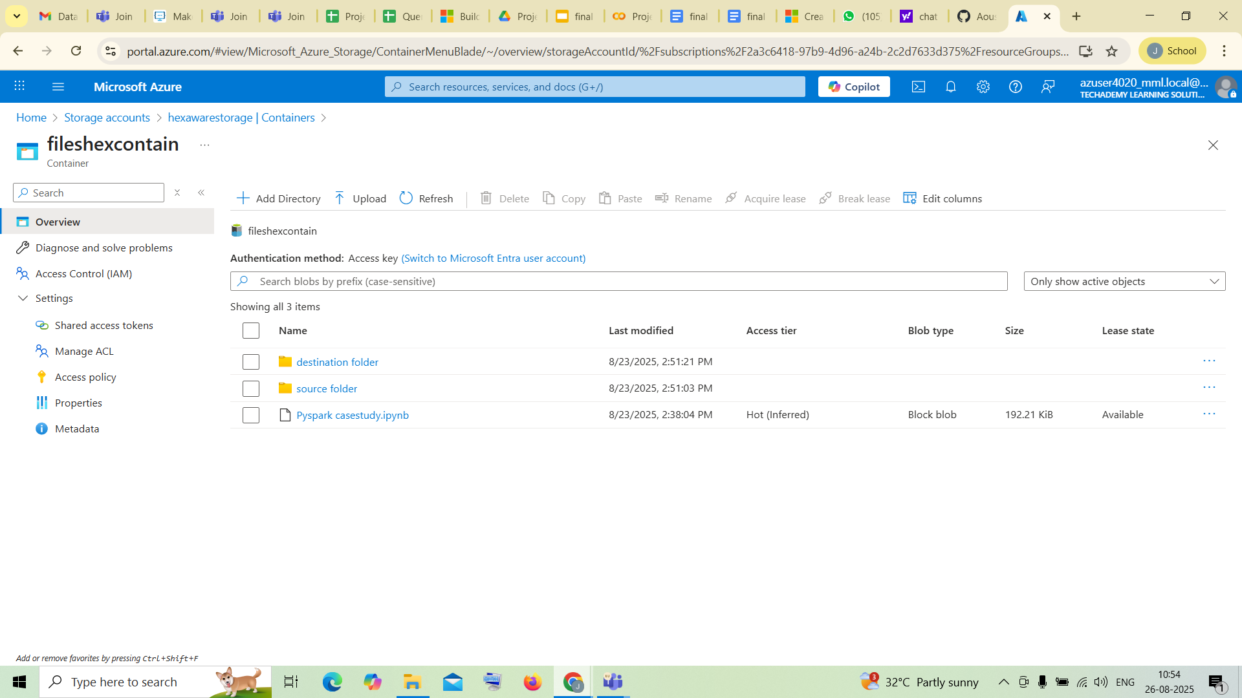
Create Source and Destination Folders
Inside your newly created storage account, you need to set up the folders for your data.
Go to the "Data Storage" section and select "Containers".
Here, you will create two distinct folders:
A Source folder to hold the data you want to copy.
A Destination folder where the copied data will be placed.

Slide 17
Configure Git Integration
It’s to connect your Data Factory to a Git repository for version control and collaboration.
In Azure Data Factory Studio, go to the Manage tab.
Under Source control, select Git configuration.
Connect your data factory to a Git repository in Azure DevOps or GitHub account, specifying a collaboration and publish branch. This ensures all your work is version-controlled.

Slide 18
Creating Linked Services
Linked services are the connection strings that define the connection information required for Data Factory to interact with external resources.
In the Manage tab, under "Connections," select Linked Services.
Click New to create a new linked service.
Choose Azure Data Lake Storage Gen2 as the type of linked service.
Specify your Azure Subscription and the Storage Account name.
Click Create to establish the connection.

Slide 19
Creating Datasets
In the Author tab, select (+) button
Create 2 datasets, one for source and another for destination
Choose Azure Data Lake Storage Gen2
Choose the file format, then it will direct you to the container
At the Source dataset, Select the source file which you want to move to the destination.
In the sink dataset, select the folder to receive the file. (destination)

Slide 20
Build and Configure the Pipeline
In the Author tab, click the + button next to Pipelines.
Drag a Copy data activity onto the pipeline canvas.
Click the Copy data activity and go to the Source tab.
Select the source dataset and sink dataset from the dropdown.
Debug and Publish
Validate your pipeline to check for any configuration errors.
Debug the pipeline by clicking the Debug button.
After a successful debug run, Publish your changes.

Slide 21
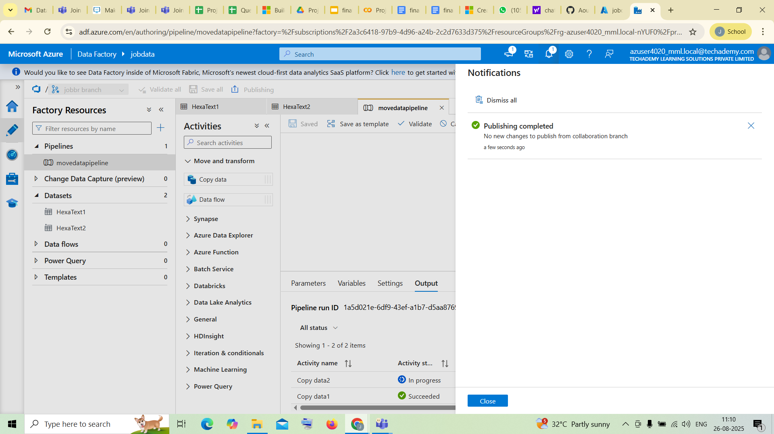
Pipelines are designed for the movement and transformation of data. They are crucial for business intelligence, data science, and analytics. A data pipeline extracts raw data from a source (like a database or a file), then loads it into a destination (a data warehouse, data lake, or another application).
They automate repetitive and often complex tasks, reducing the risk of human error and freeing up engineers to focus on more strategic work.

Slide 22
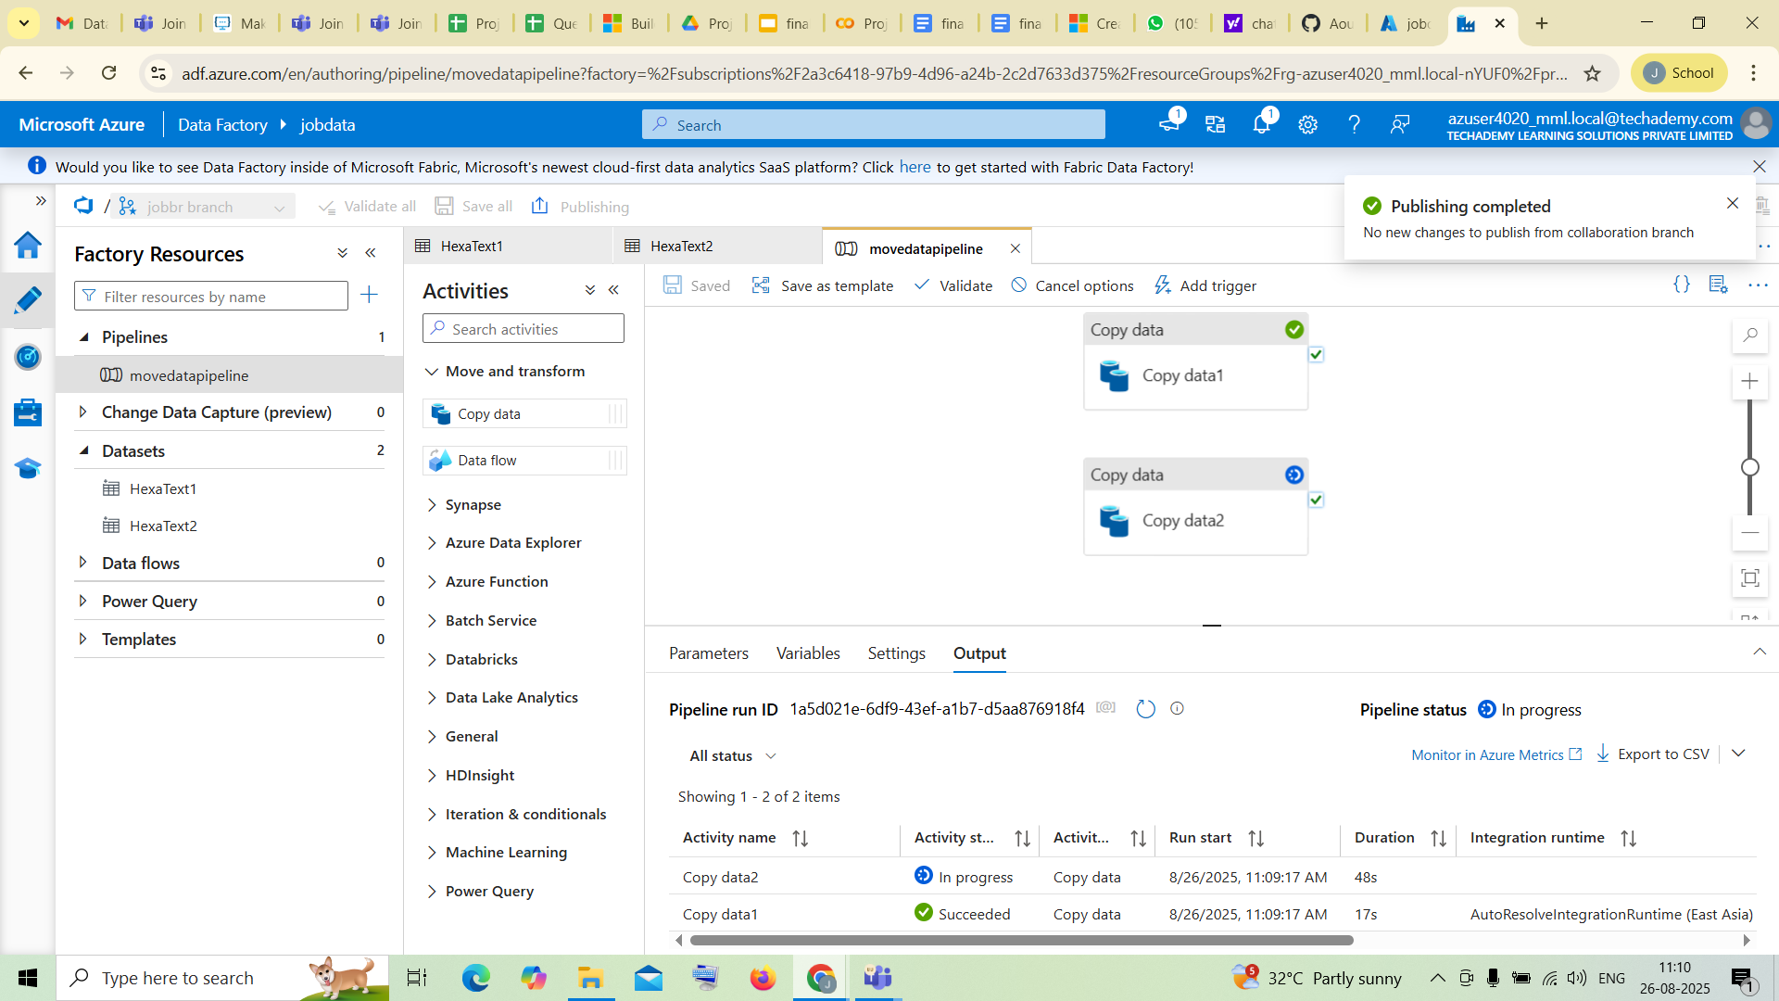
Output
Publishing Completed

Slide 23
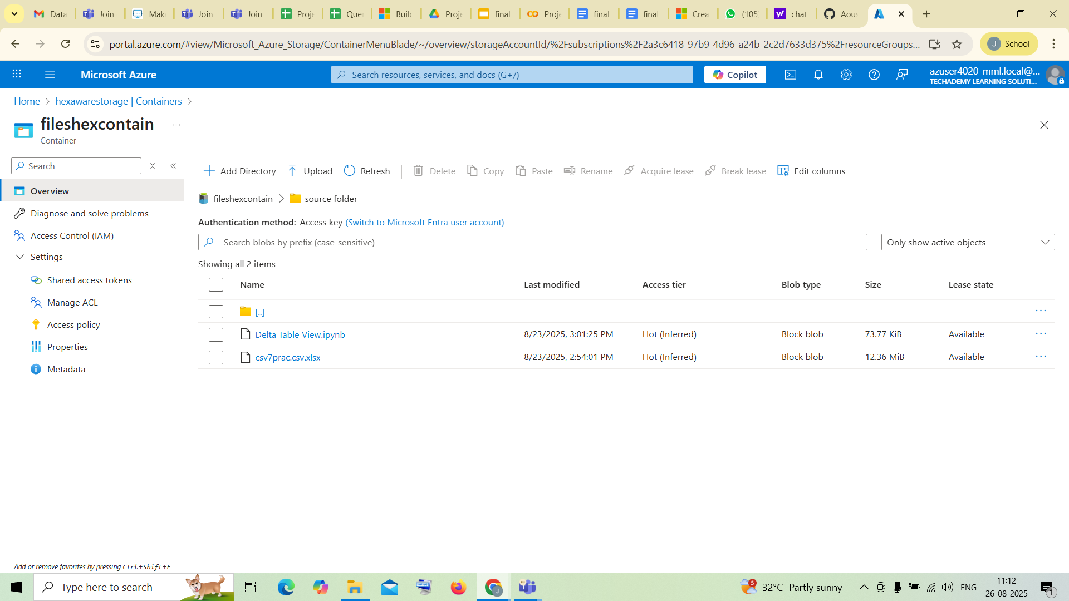
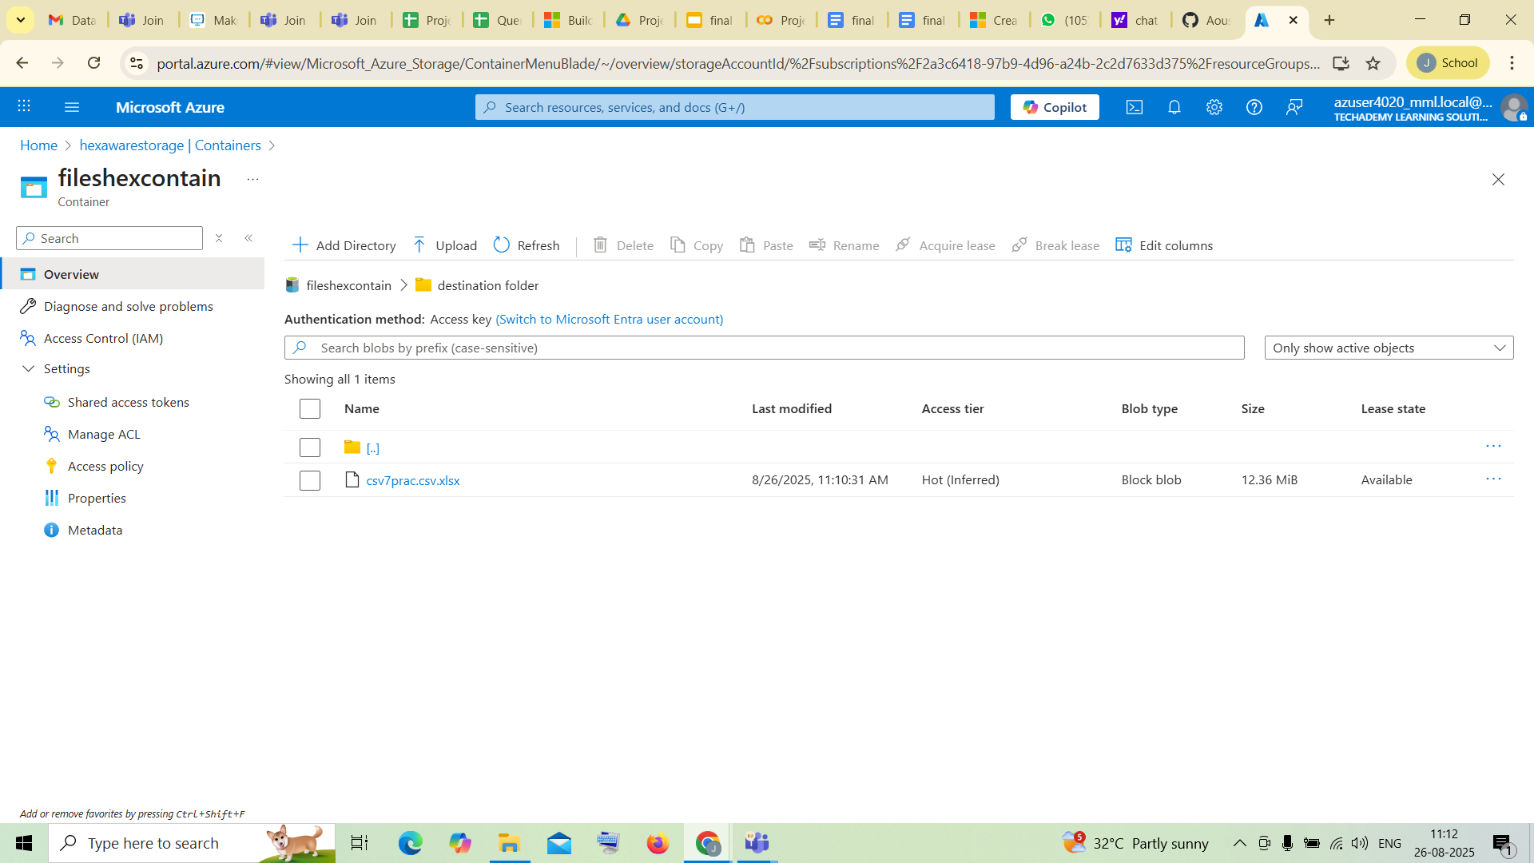
After publishing , open your Storage Account and verify that your file in the destination folder.

Slide 24
Conclusion
This integration provides a robust, scalable, and auditable architecture for managing data pipelines. By leveraging Git-based version control, ARM template-driven CI/CD, and ADF pipelines targeting ADLS Gen2, organizations gain agility, repeatability, and compliance with supporting enterprise, grade data workflows in Azure.
Scalable & High-Performing: Parallel execution and optimized storage drive efficiency.
Operationally Resilient: Integrated monitoring and CI/CD ensure reliability.
More Than Movement: Smart, secure, sustainable data management.

